Slide 1




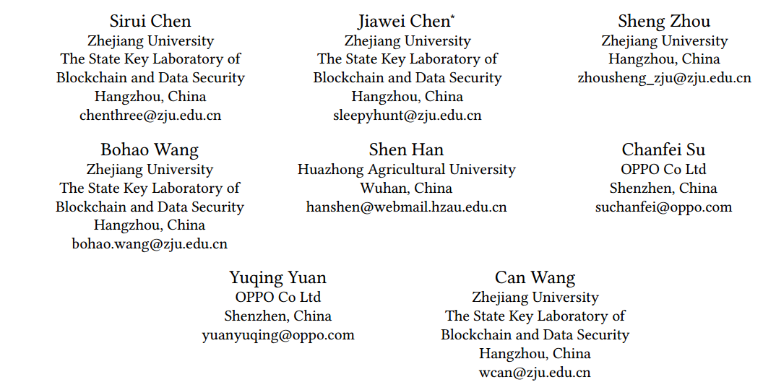





ATAI
Advanced Techniqueof Artificial Intelligence
ATAI
ChongqingUniversity _{AdvancedTechniqueof}
of Technology Artificial Intelligence
Chongqing University of
Technology
Chongqing University ^{ATAI}
_{of Technology} Advanced Techniqueof
Artificial Intelligence
Chongqing University of Technology
Chongqing University of Technology
SIGformer: Sign-aware Graph Transformer for Recommendation
Code: https://github.com/StupidThree/SIGformer.
2024.9. 15•ChongQing
—— SIGIR 2024
Reported by Yao Yao Zhang
1

Slide 2

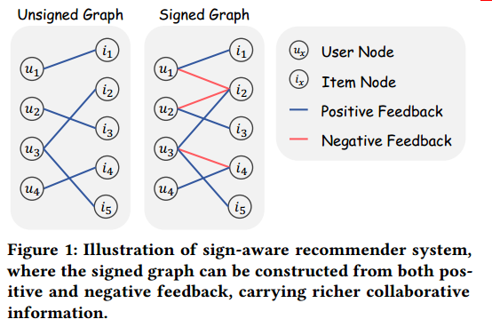
ATAI
AdvancedTechniqueof
Artificial Intelligence
ATAI
ChongqingUniversity _{AdvancedTechniqueof}
of Technology Artificial Intelligence
ChongqingUniversity of Technology
Motivation
（1）The existing efforts to incorporate both types of feedback are sparse and face two main limitations:1) They process positive and negative feedback separately, which fails to holistically leverage the collaborative information within the signed graph; 2) They rely on MLPs or GNNs for information extraction from negative feedback, which may not be effective.

Slide 3

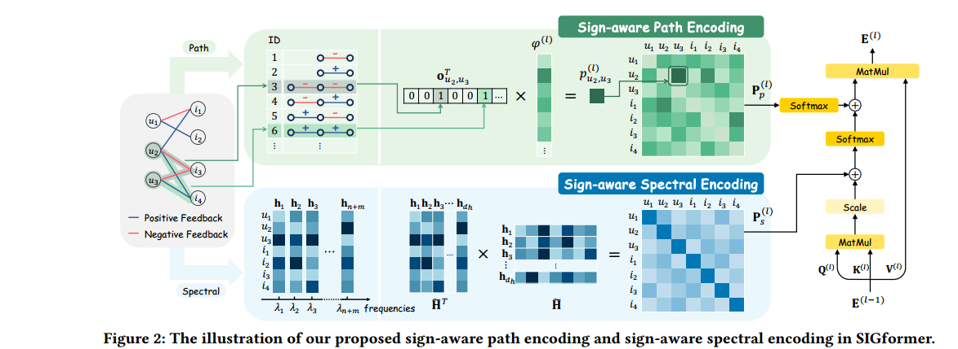
ChongqingUniversity of Technology
ATAI
AdvancedTechniqueof
Artificial Intelligence
ATAI
ChongqingUniversity _{AdvancedTechniqueof}
of Technology Artificial Intelligence
Overview

Slide 4



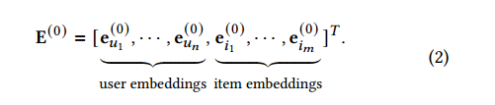
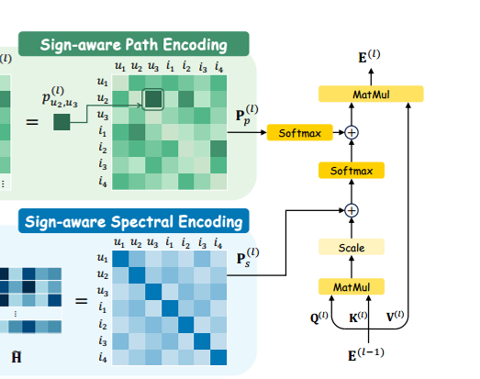
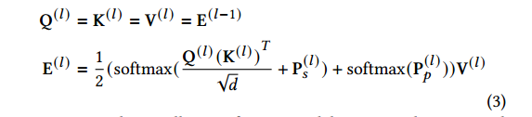
ChongqingUniversity of Technology
ATAI
AdvancedTechniqueof
Artificial Intelligence
ATAI
ChongqingUniversity _{AdvancedTechniqueof}
of Technology Artificial Intelligence
Method

Slide 5

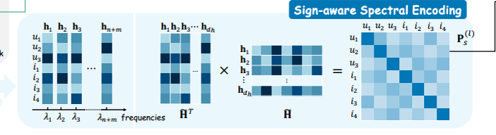

ChongqingUniversity of Technology
ATAI
AdvancedTechniqueof
Artificial Intelligence
ATAI
ChongqingUniversity _{AdvancedTechniqueof}
of Technology Artificial Intelligence
Method

Slide 6

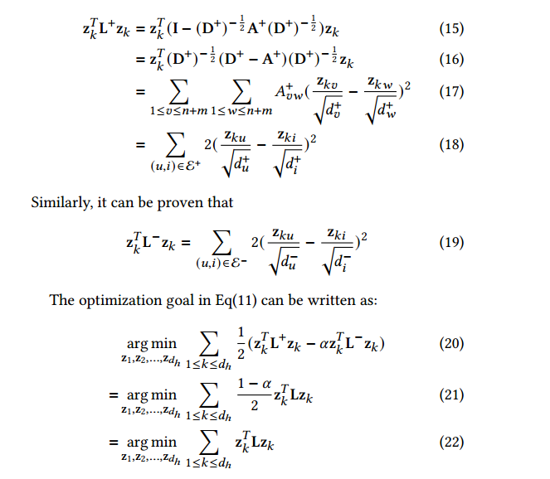

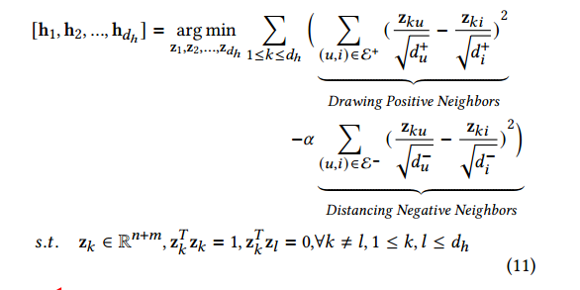
ChongqingUniversity of Technology
ATAI
AdvancedTechniqueof
Artificial Intelligence
ATAI
ChongqingUniversity _{AdvancedTechniqueof}
of Technology Artificial Intelligence
Method

Slide 7

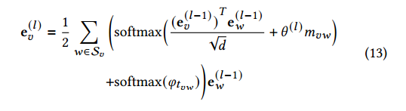

ChongqingUniversity of Technology
ATAI
AdvancedTechniqueof
Artificial Intelligence
ATAI
ChongqingUniversity _{AdvancedTechniqueof}
of Technology Artificial Intelligence
Method

Slide 8

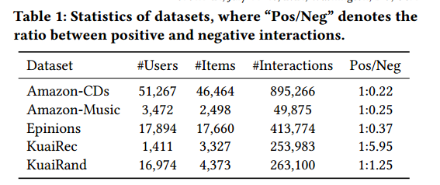
ATAI
AdvancedTechniqueof
Artificial Intelligence
ATAI
ChongqingUniversity _{AdvancedTechniqueof}
of Technology Artificial Intelligence
ChongqingUniversity of Technology
Experiments

Slide 9
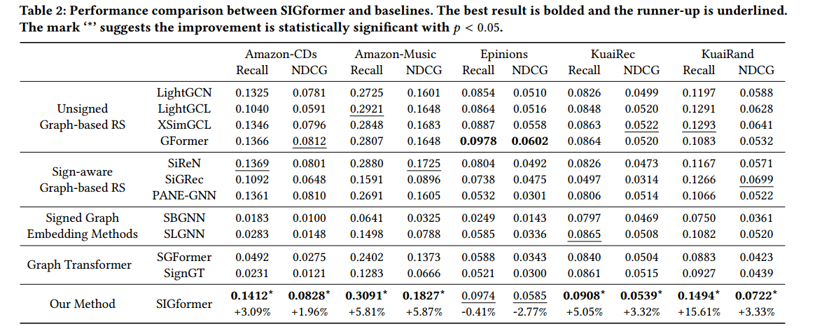
ATAI
AdvancedTechniqueof
Artificial Intelligence
ATAI
ChongqingUniversity _{AdvancedTechniqueof}
of Technology Artificial Intelligence
ChongqingUniversity of Technology
Experiments

Slide 10
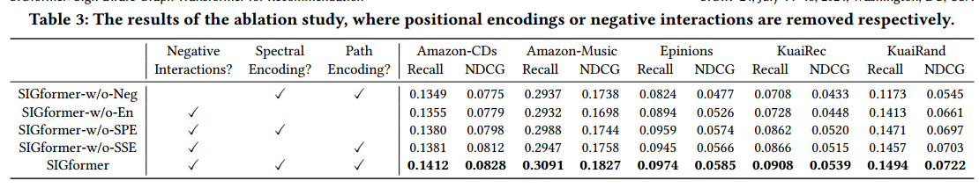
ATAI
AdvancedTechniqueof
Artificial Intelligence
ATAI
ChongqingUniversity _{AdvancedTechniqueof}
of Technology Artificial Intelligence
ChongqingUniversity of Technology
Experiments

Slide 11
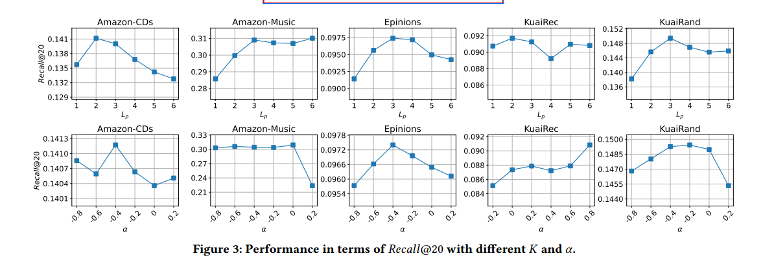
ATAI
AdvancedTechniqueof
Artificial Intelligence
ATAI
ChongqingUniversity _{AdvancedTechniqueof}
of Technology Artificial Intelligence
ChongqingUniversity of Technology
Experiments

Slide 12
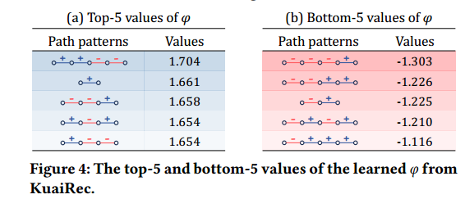
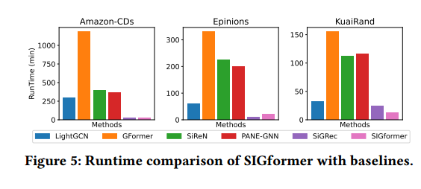
ATAI
AdvancedTechniqueof
Artificial Intelligence
ATAI
ChongqingUniversity _{AdvancedTechniqueof}
of Technology Artificial Intelligence
ChongqingUniversity of Technology
Experiments

Slide 13


ChongqingUniversity of Technology
ATAI
AdvancedTechniqueof
Artificial Intelligence
ATAI
ChongqingUniversity _{AdvancedTechniqueof}
of Technology Artificial Intelligence
Thanks!

